Slide 1
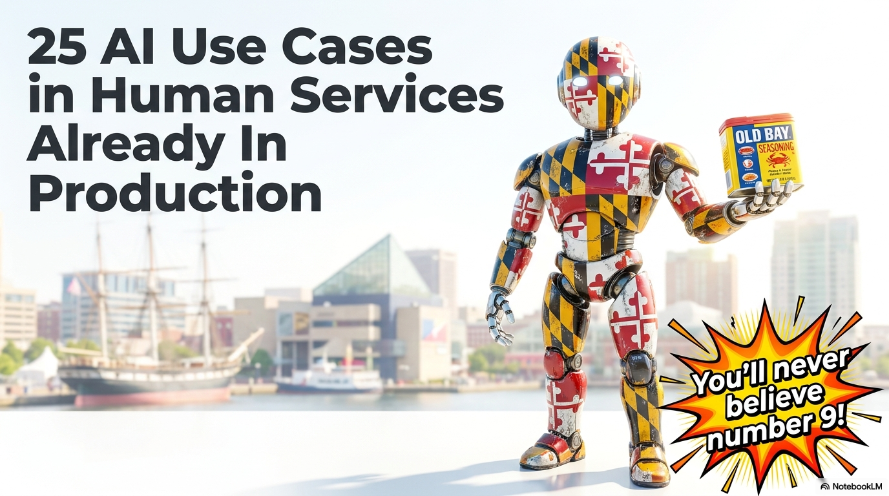
25 AI Use Cases in Human Services Already In Production

Slide 2
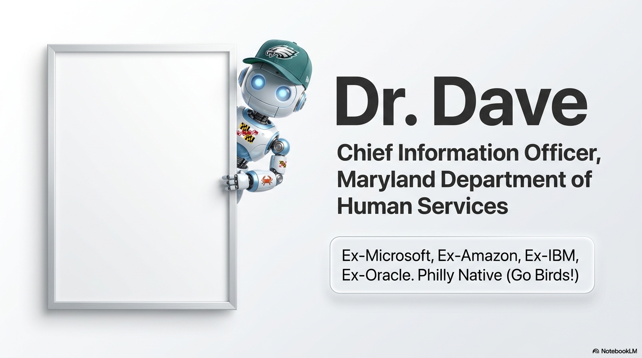
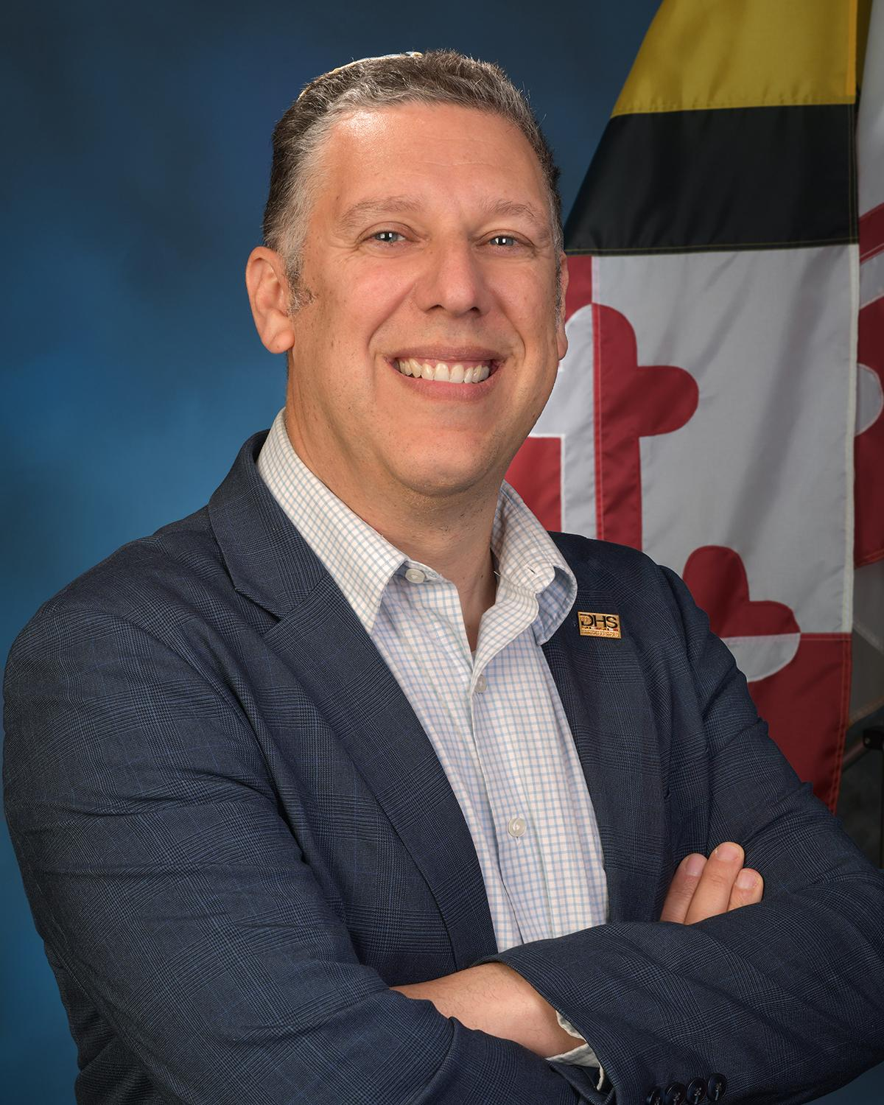
Dr. Dave, Chief Information Officer, Maryland Department of Human Services

Slide 3
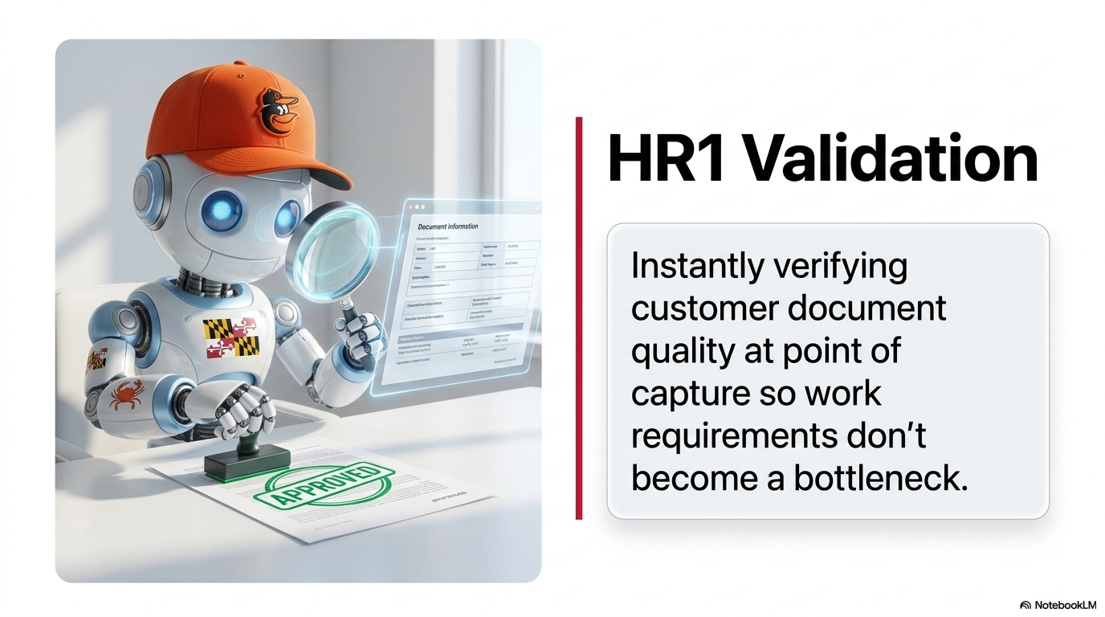
HR1 Validation

Slide 4

Fiscal Manual Tutor

Slide 5
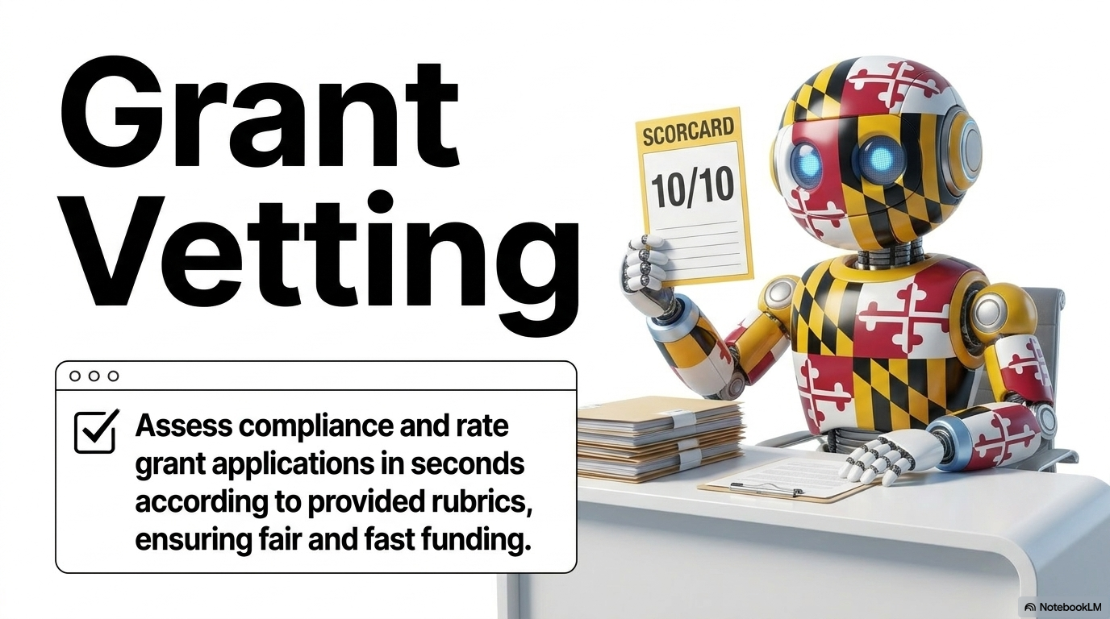
Grant Vetting

Slide 6
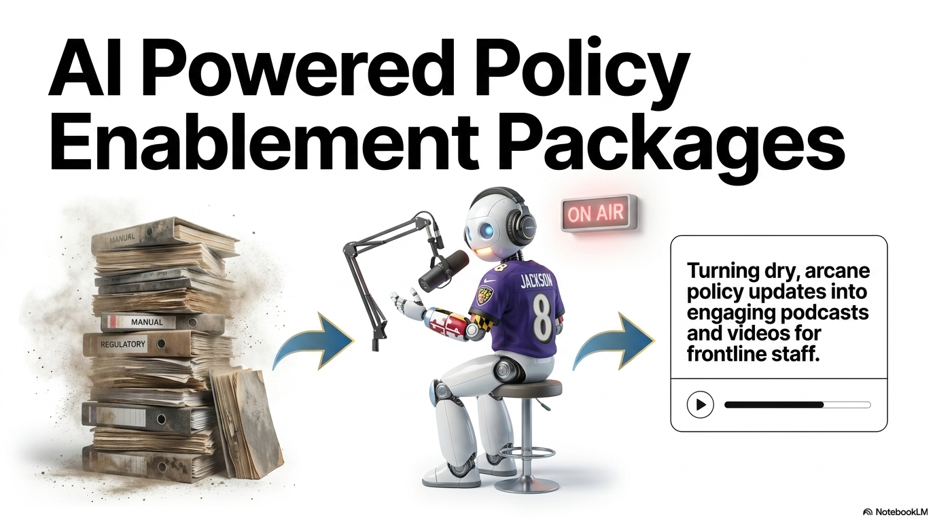
AI Powered Policy Enablement Packages

Slide 7
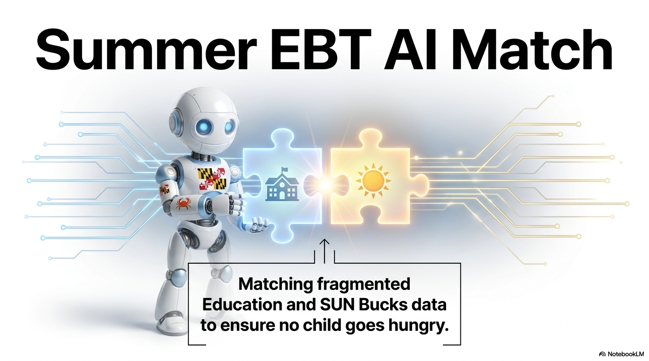
Summer EBT AI Match

Slide 8
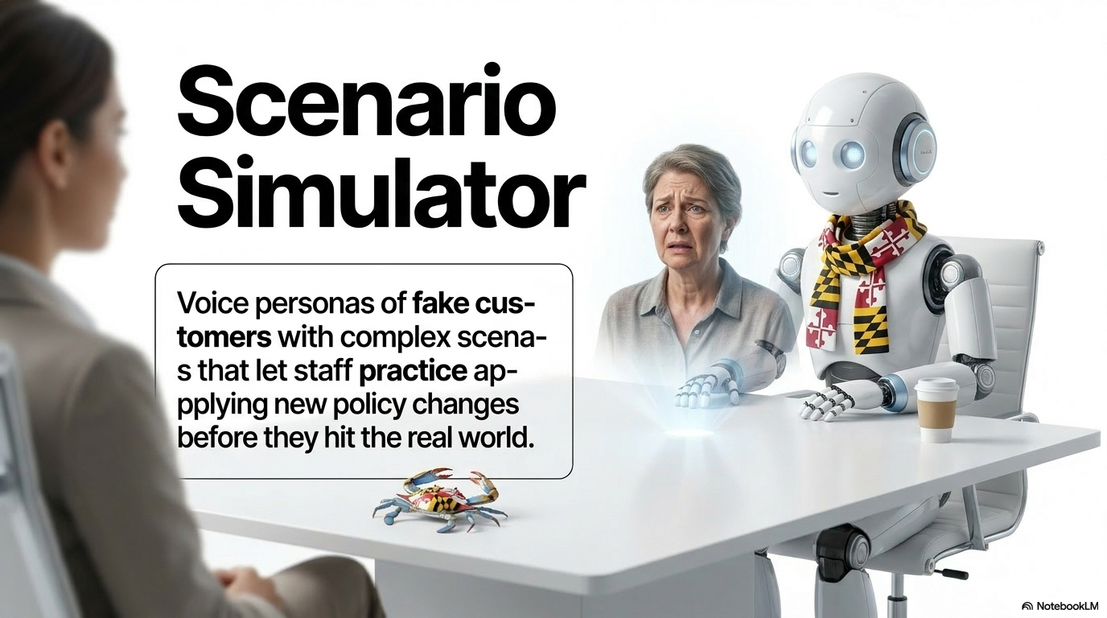
Scenario Simulator
Voice personas of fake customers with complex scenarios that let staff practice applying new policy changes before they hit the real world.

Slide 9
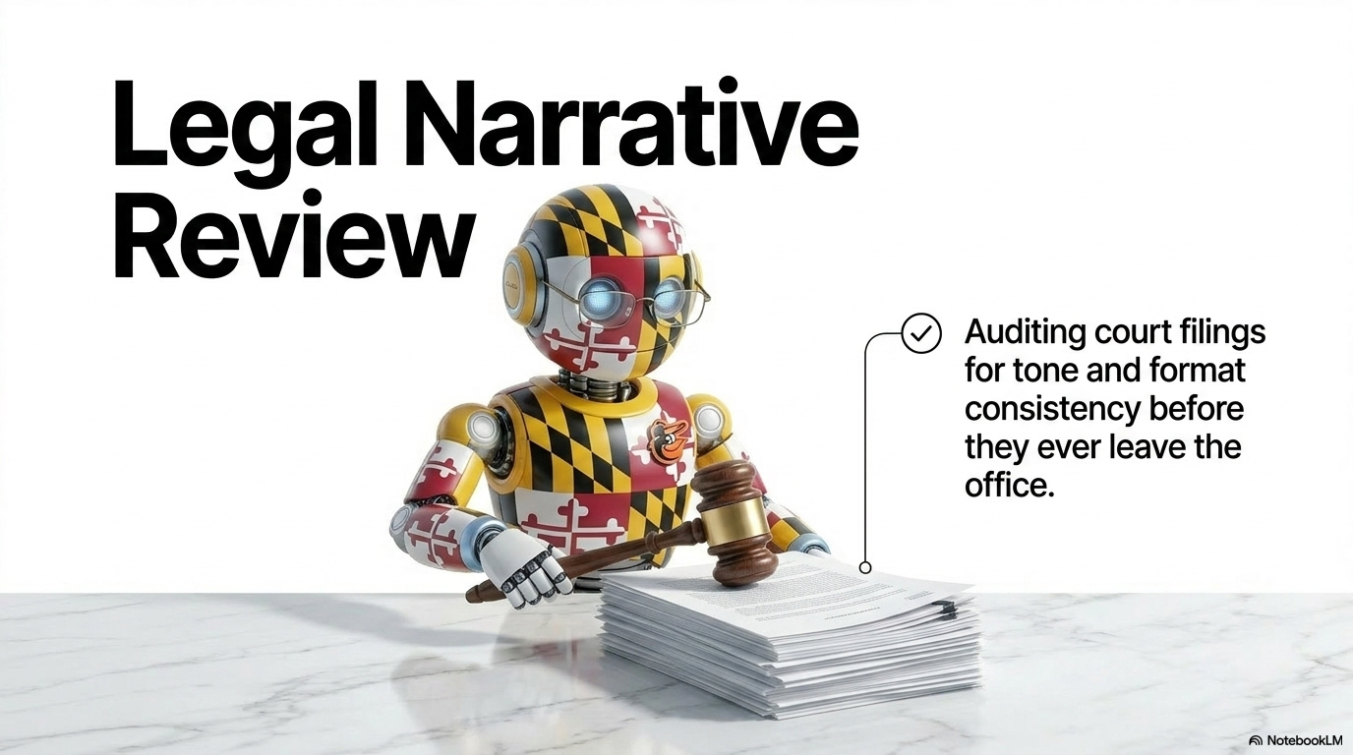
Legal Narrative Review

Slide 10
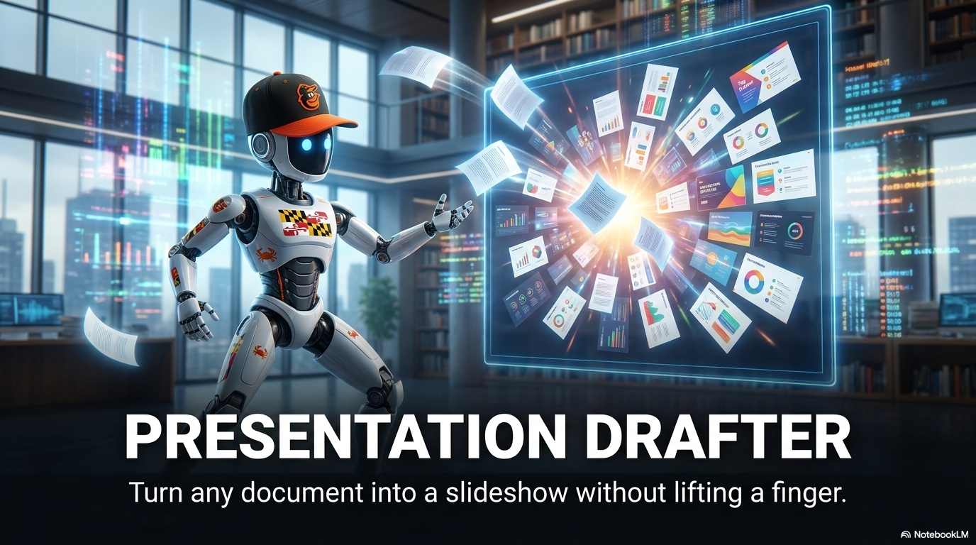
Presentation Drafter

Slide 11
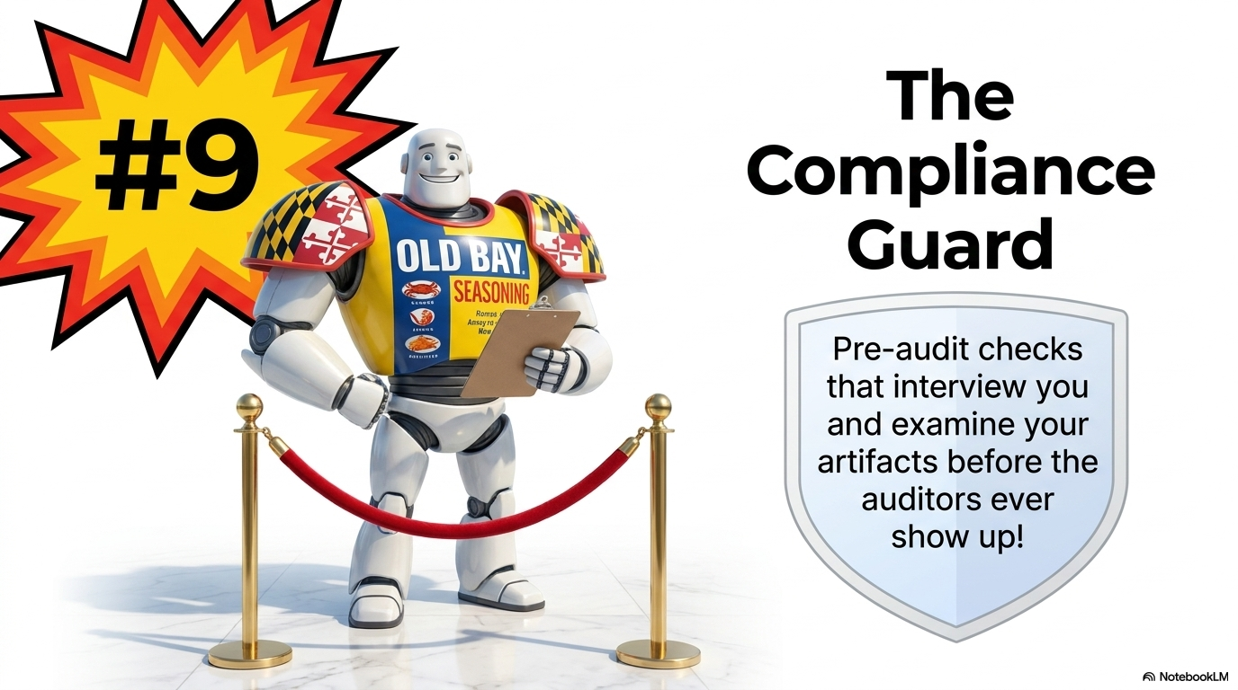
The Compliance Guard

Slide 12
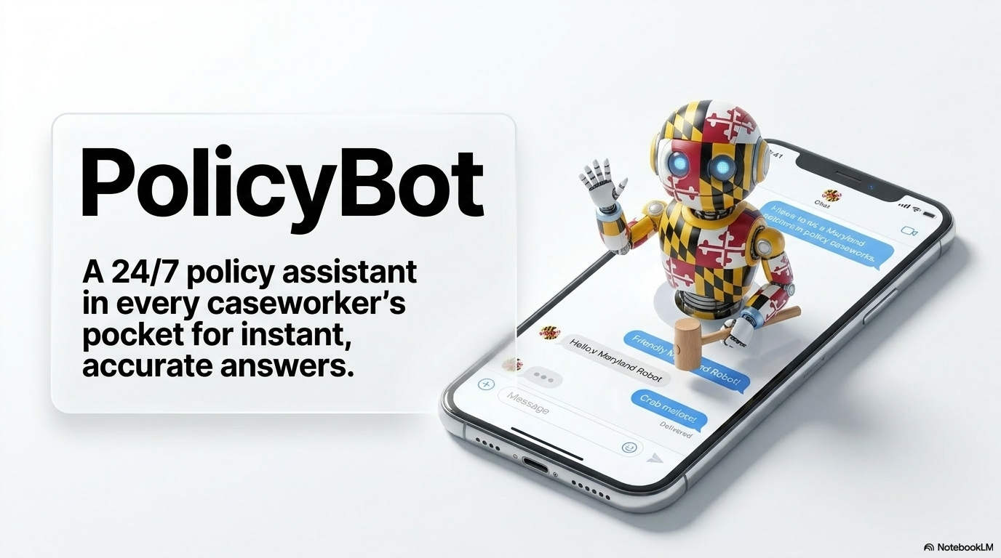
PolicyBot

Slide 13
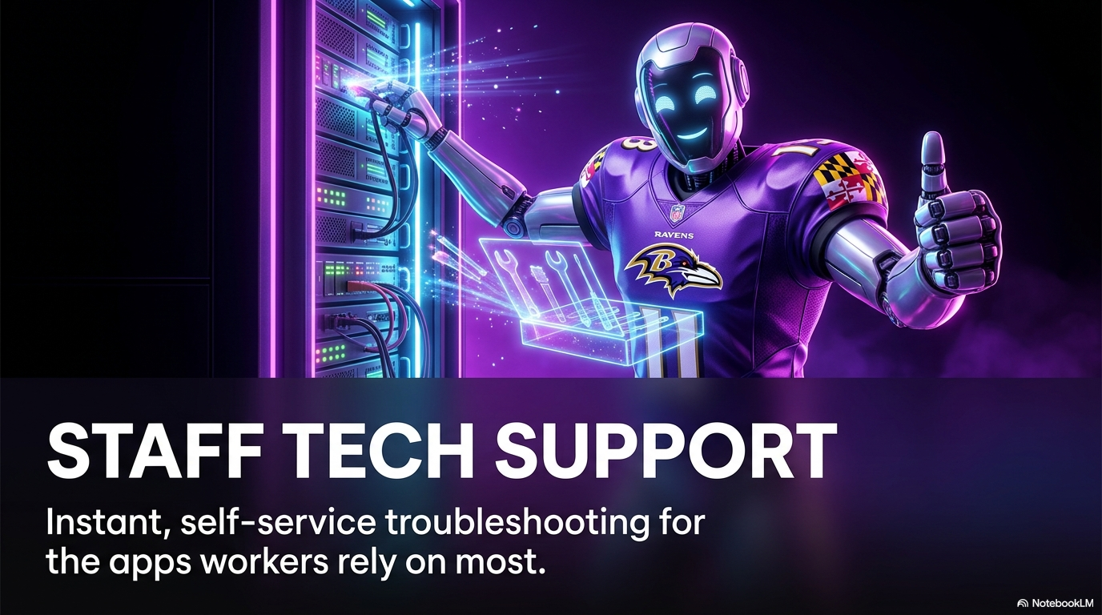
Staff Tech Support

Slide 14
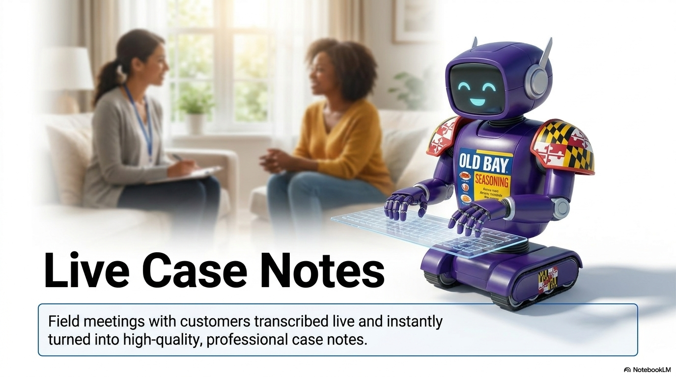
Live Case Notes

Slide 15
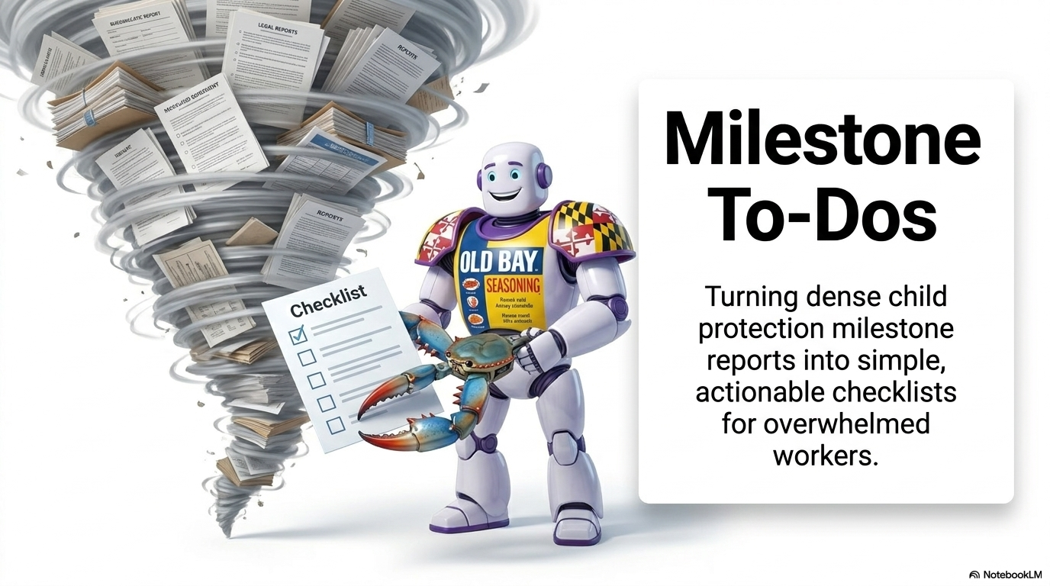
Milestone To-Dos

Slide 16
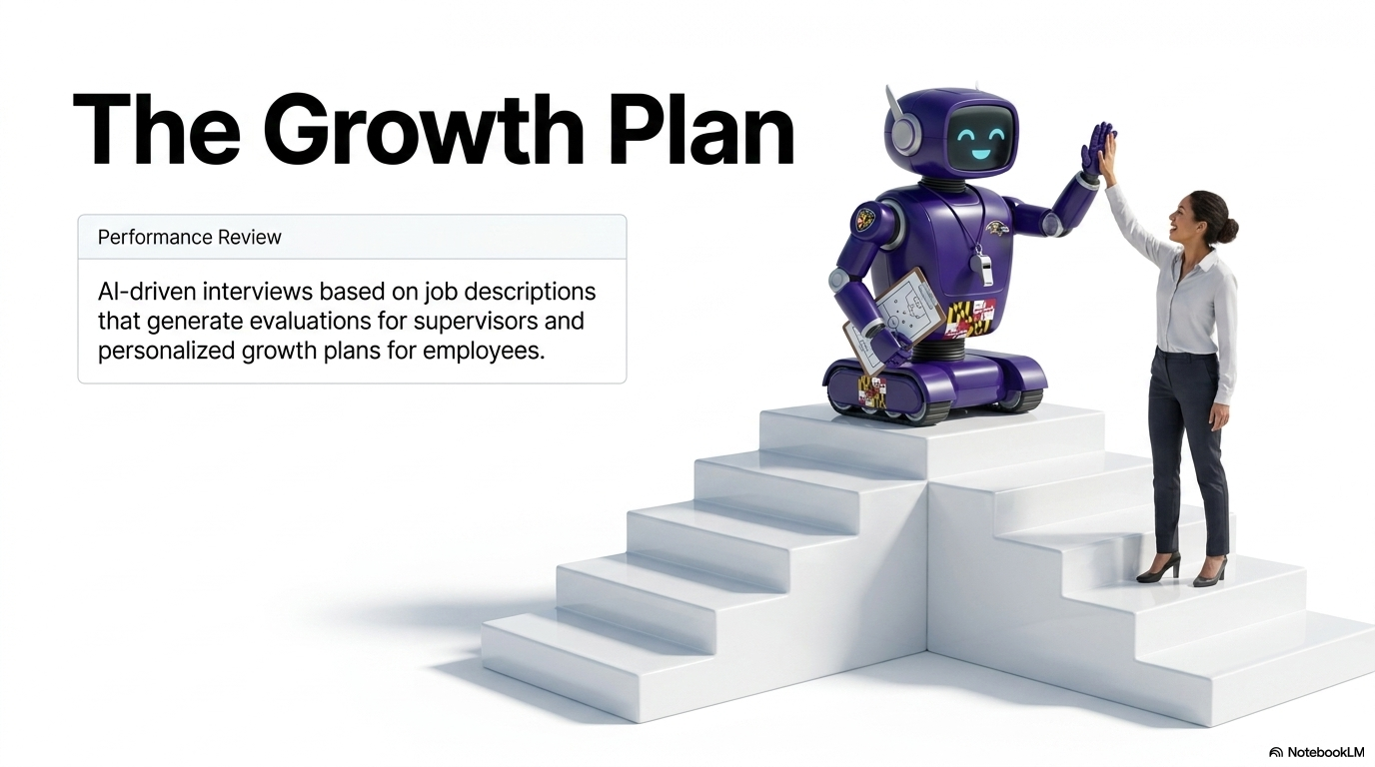
The Growth Plan

Slide 17
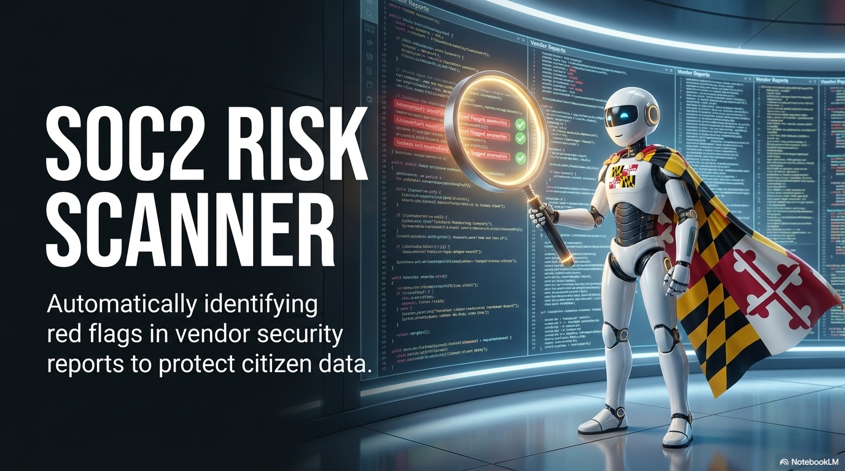
SOC2 Risk Scanner

Slide 18
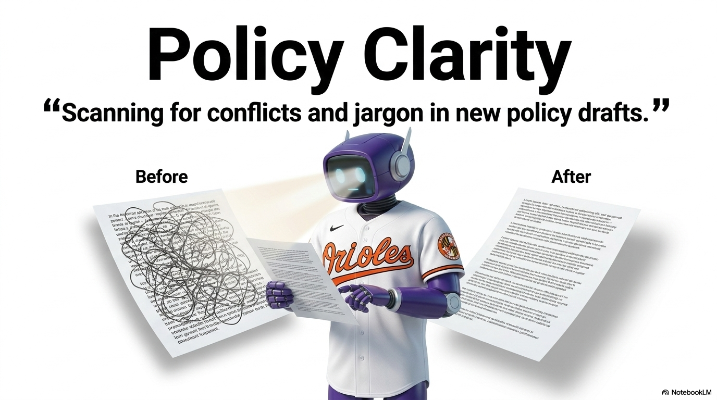
Policy Clarity

Slide 19
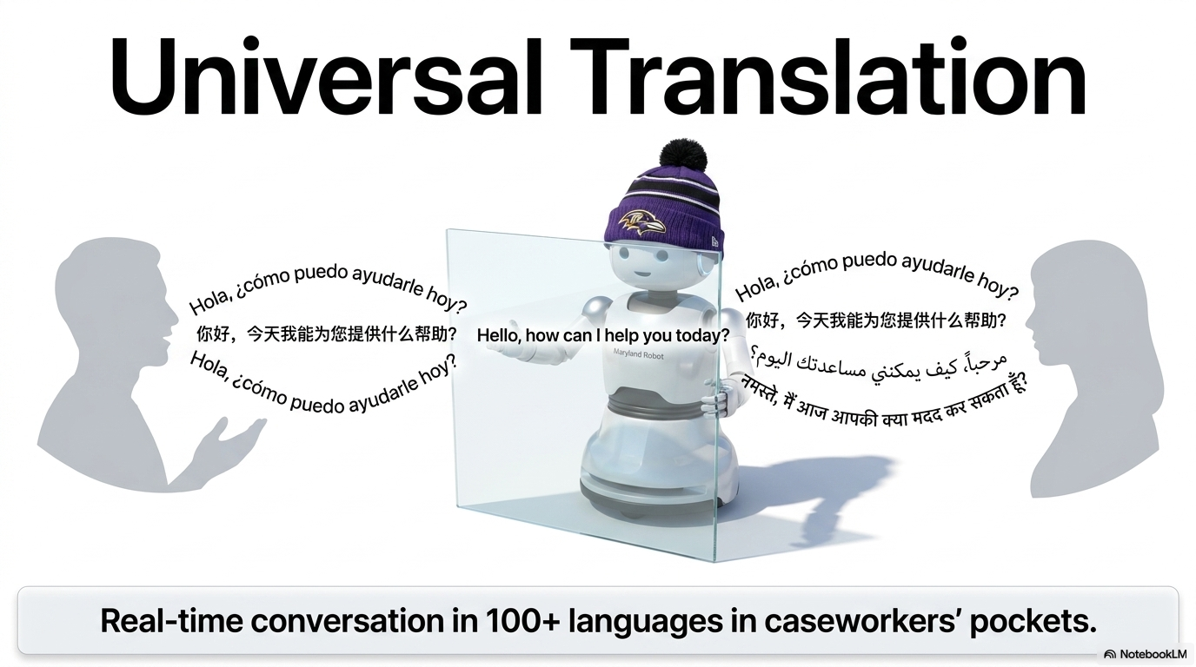
Universal Translation

Slide 20
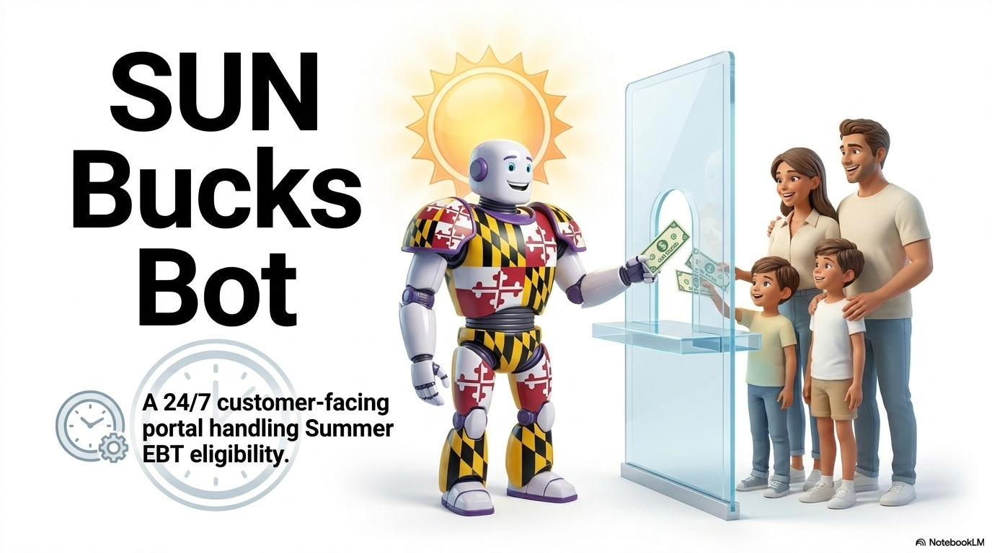
SUN Bucks Bot

Slide 21
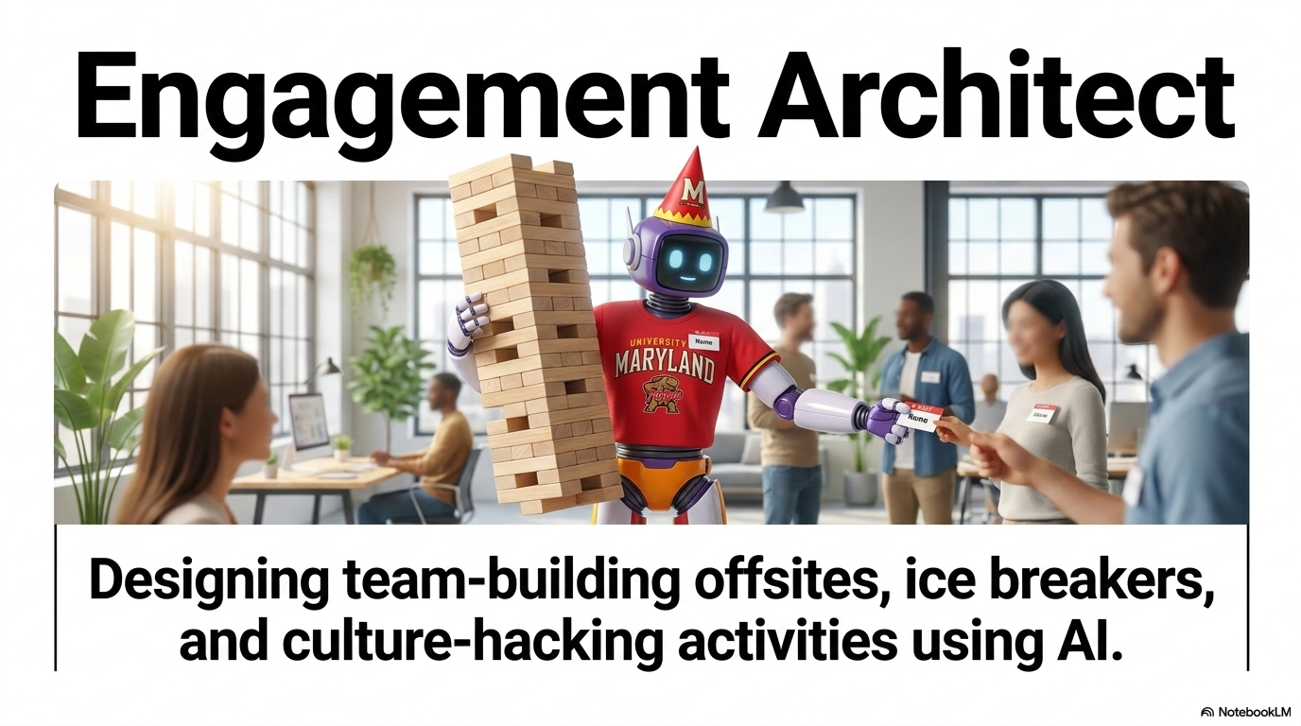
Engagement Architect

Slide 22
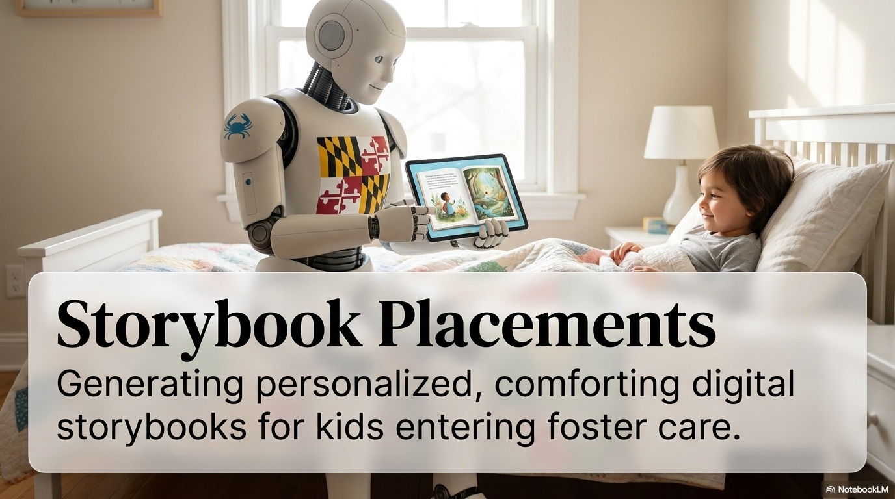
Storybook Placements

Slide 23
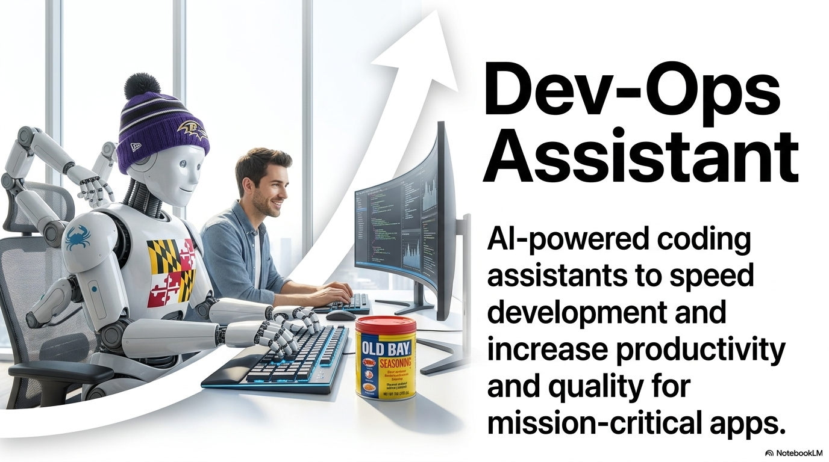
Dev-Ops Assistant

Slide 24
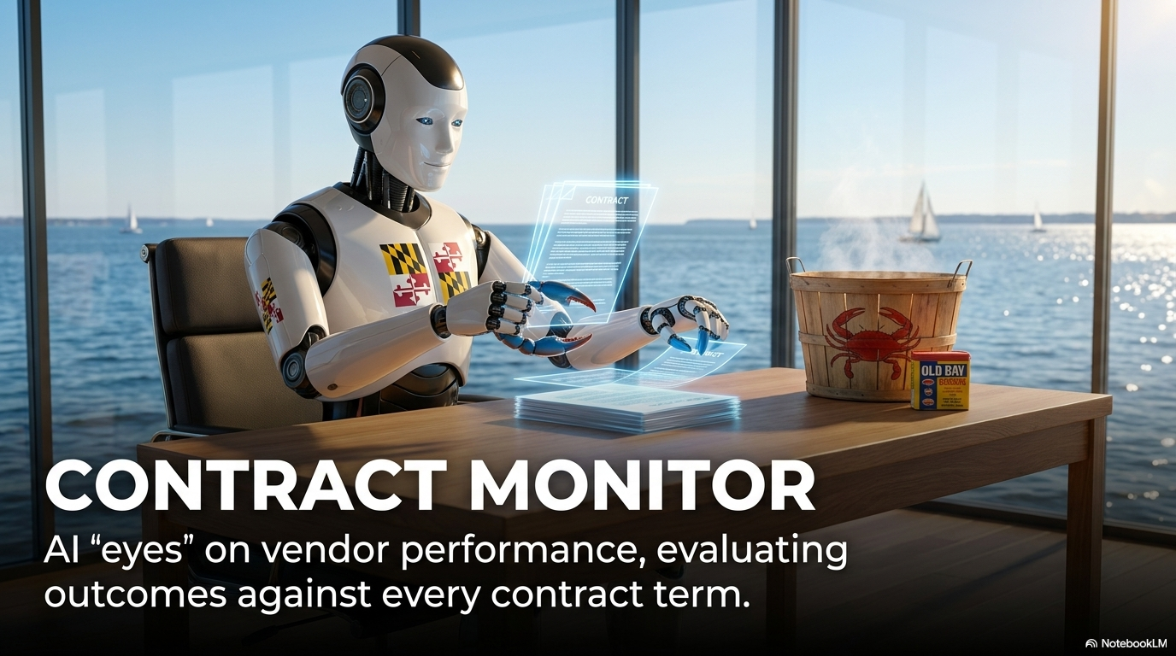
Contract Monitor

Slide 25
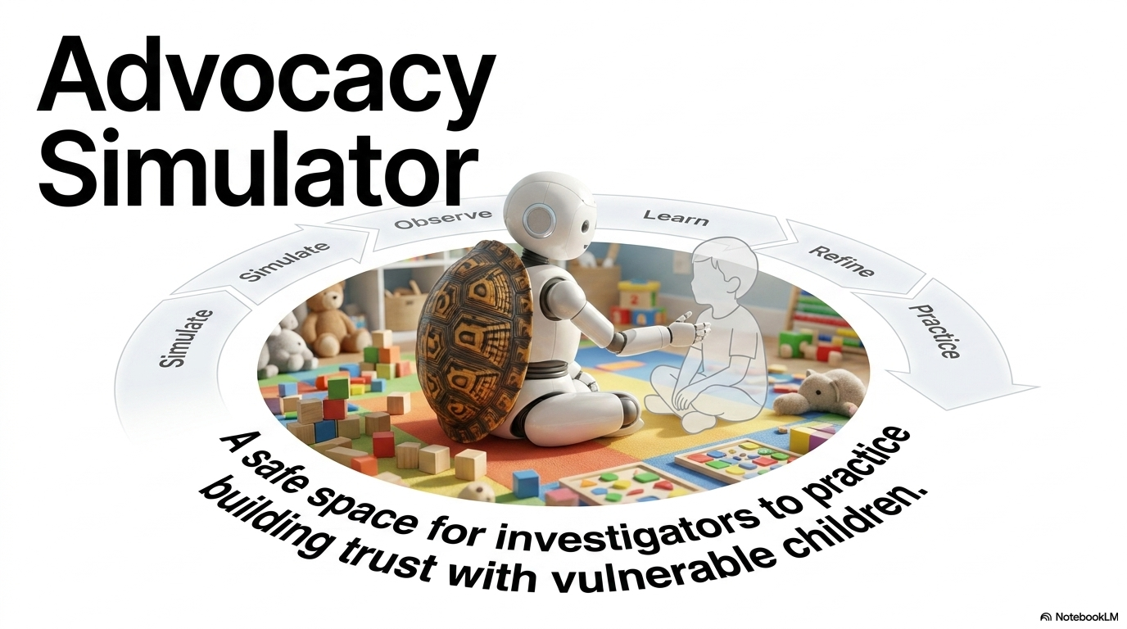
Advocacy Simulator

Slide 26
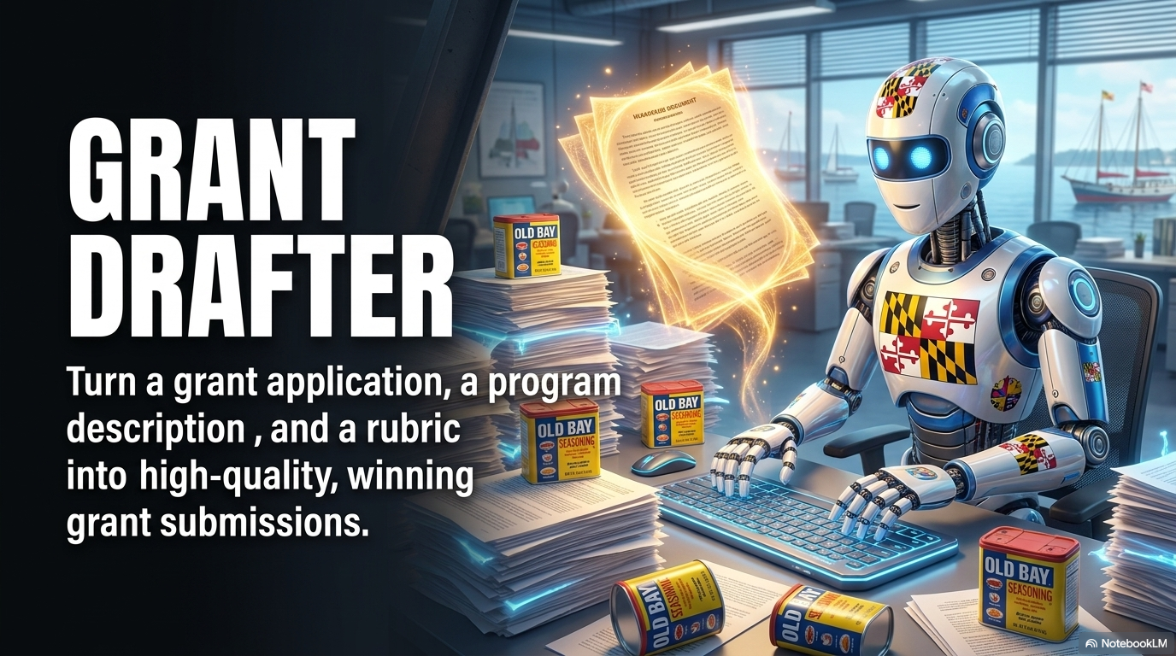
Grant Drafter

Slide 27
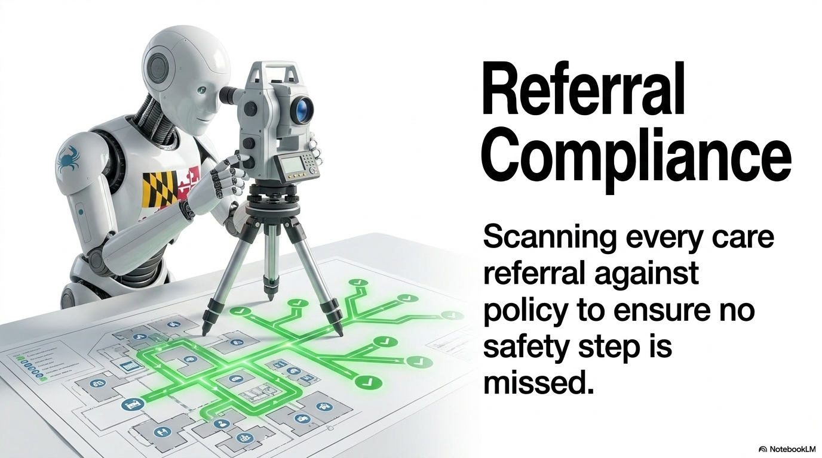
Referral Compliance

Slide 28
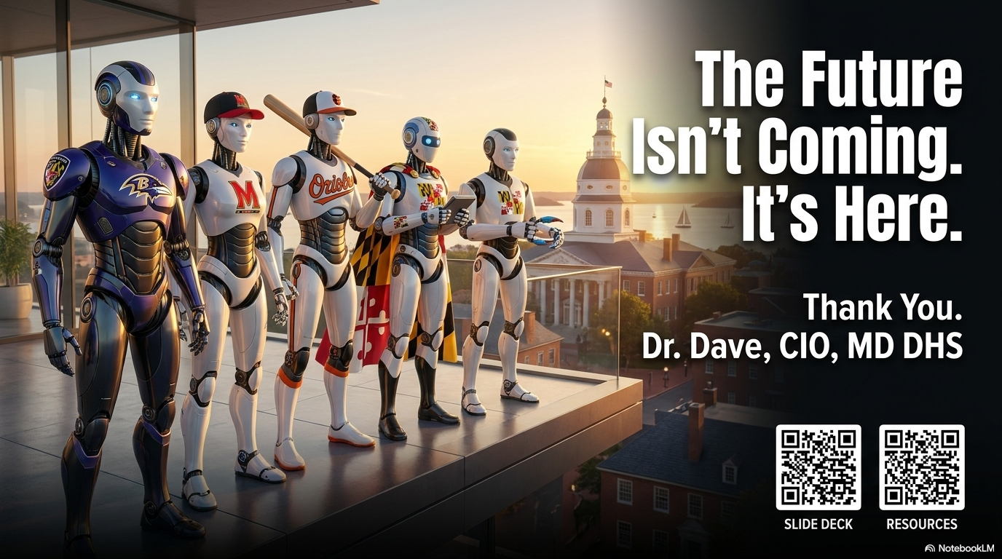
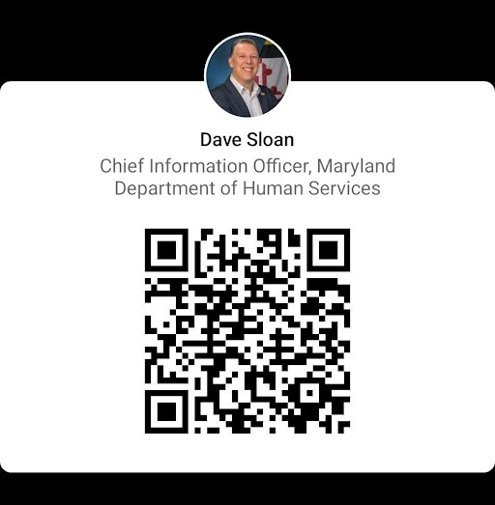
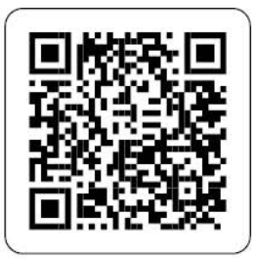
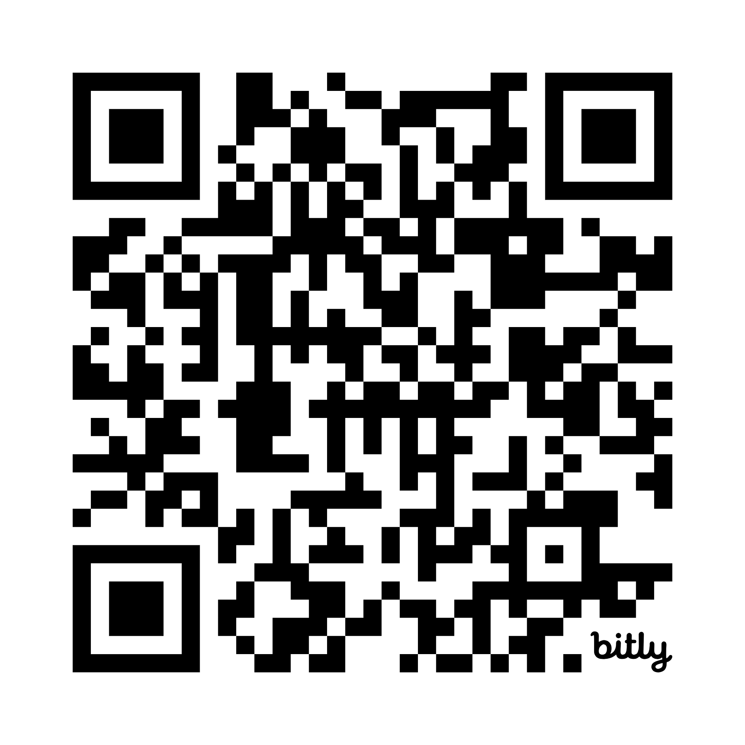
The Future Isn’t Coming. It’s Here.

